Slide 1
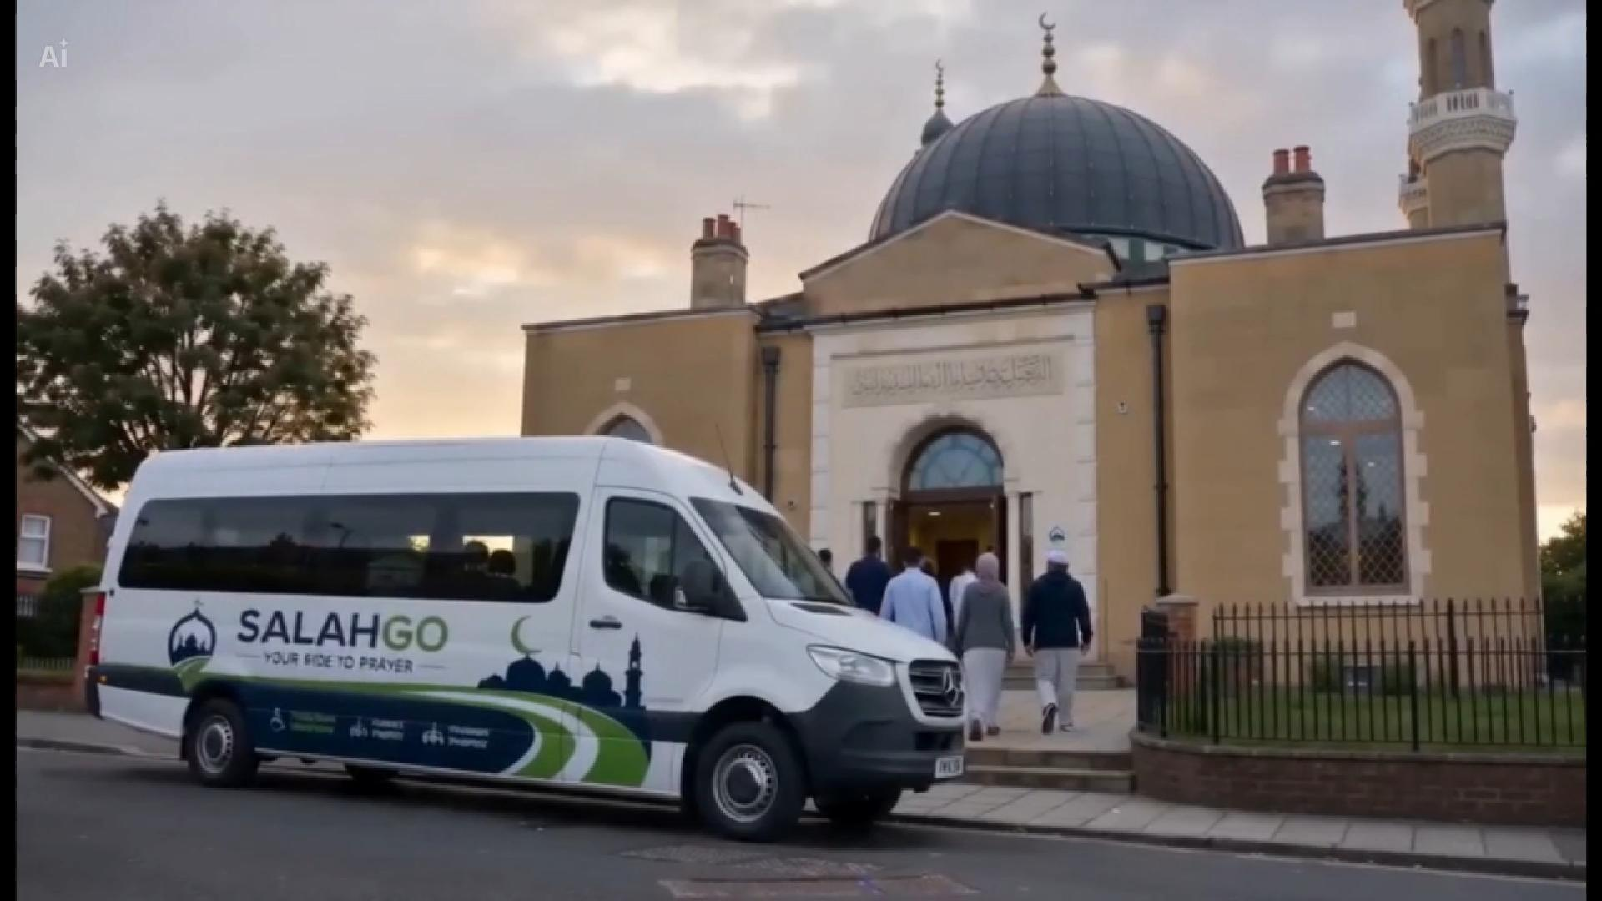

MASJID AYESHA LAUNCH PILOT
SalahGo
Your Ride To Prayer
Helping People Reach The Mosque, Not Just Transporting Them There.
Embedded pilot video - click to play in PowerPoint
Qur'an 5:2 - help one another in goodness and mindful duty.
Notes:
Open with the purpose, not the app. Say: this is about helping people reach prayer, learning and community life.
Position SalahGo as a community transport and attendance service beginning with Masjid Ayesha.
Play the film early so the mosque can see the service as practical and local, not abstract.

Slide 2
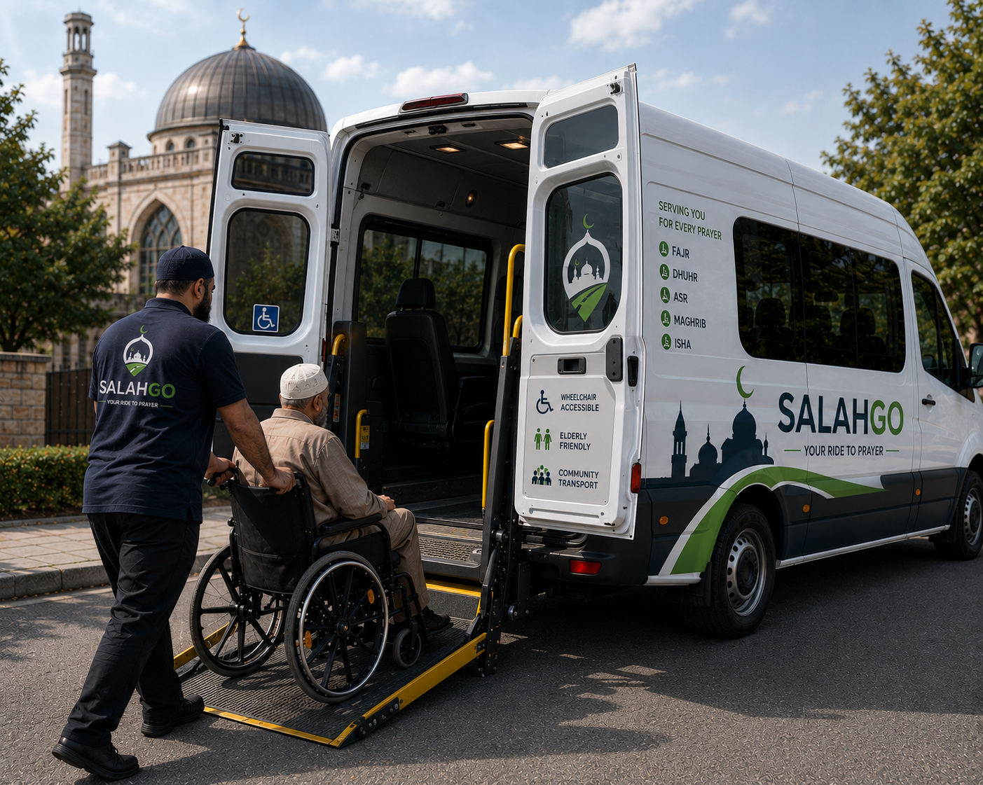
THE PROBLEM
Transport barriers quietly exclude people from mosque life.
Parking, charges, congestion, accessibility needs, family schedules, anxiety and first-time attendance all turn a simple visit into a barrier.
Parking pressure
Accessibility needs
Restrictions, charges and road congestion around busy prayers.
Wheelchair boarding, elderly mobility and step-free support.
Family complexity
First-time anxiety
Madrasa, school-linked mosque journeys, work and prayer windows overlap.
New Muslims and isolated members need a clear, safe route.
Qur'an 17:70 - human dignity must be honoured.
Notes:
Make this personal to Masjid Ayesha: this is about people already wanting to attend.
Ask gently whether this sounds familiar: parking pressure, elderly members missing activities, sisters needing safer travel, parents juggling madrasa pickups.
The strongest problem is exclusion from worship, learning and community because the journey is hard.

Slide 3

WHY SALAHGO
A mosque-centred service, not a taxi app.
Prayers
Madrasa journeys
Fajr, Jumuah, Maghrib and Isha windows where demand is proven.
Normal booking choice with guardian and handover fields.
The mosque remains the hub. SalahGo handles booking, route clarity, accessibility needs, sponsor seats and simple journey records.
Community events
Accessible journeys
Sisters' circles, elderly programmes, seminars and family activities.
Wheelchair space, companion seat and step-free support notes.
Qur'an 49:13 - communities are made to know and care for one another.
Notes:
This slide prevents SalahGo being reduced to bus booking.
Use plain language: SalahGo helps the mosque organise journeys for prayer, learning, sisters, elderly members and families.
Avoid technical phrases here. The committee needs to hear what improves for the community.

Slide 4
MORE THAN TRANSPORT
The first screen should feel like Masjid Ayesha is active today.
Masjid Ayesha Hub
Today
Asr
Transport available
The app becomes a clear home for mosque activities: upcoming prayers, classes, circles, seminars and transport availability in one place.
Maghrib
3 seats left
Madrasa journey
Booking open
Sisters' circle
Pickup points open
Hajj seminar
Sponsor seats enabled
Book a community journey
Qur'an 24:36 - houses of worship are places where Allah is remembered.
Notes:
The app should show community life before the booking form.
When presenting, say the first screen should feel like Masjid Ayesha is alive today: prayers, madrasa, sisters' circles, seminars and elderly support.
This transforms the idea from transport supply to attendance and participation.

Slide 5
PILOT ZONE
Tottenham first. Wider London later.
Future partner map
Seven Sisters Masjid
Seven Sisters Islamic Centre - Musjid
Assunnah Islamic Centre
London Islamic Cultural Society and Mosque
Wood Green Fatih Mosque
Finsbury Park Mosque
Tottenham Hale Mosque & Community Centre
A focused pilot shows what really happens: actual pickup points, actual Friday demand, actual safeguarding needs and actual volunteer interest.
1. Hub: Dawatul Islam Community & Cultural Centre, Masjid Ayesha
2. Area: Tottenham, Seven Sisters, Tottenham Hale, Manor House and West Green Road
3. First route: Masjid Ayesha Loop
4. Expansion only after evidence: second route, then partner mosques
Qur'an 2:148 - compete with one another in good works.
Notes:
Say explicitly that we are not trying to cover London at launch.
This should reassure the mosque that the pilot is manageable: one mosque, one route, one timetable, then careful learning.
If they ask about other mosques, say those are future partners after Masjid Ayesha proves the first route.

Slide 6
PHASE 1 ROUTE
The Masjid Ayesha Loop is simple enough to run, measure and improve.
1
Seven Sisters Station
2
Tottenham Hale Station
One bus. One route. One mosque. One timetable. The first target is reliability, not complexity.
3
Manor House
4
West Green Road
5
Masjid Ayesha
Qur'an 62:9 - answer the call to remembrance.
Notes:
This slide should be easy to explain without a map.
The whole point is a simple Friday pilot before building a wider network.
Read the stops slowly and ask whether any pickup point should be adjusted before the first trial.

Slide 7
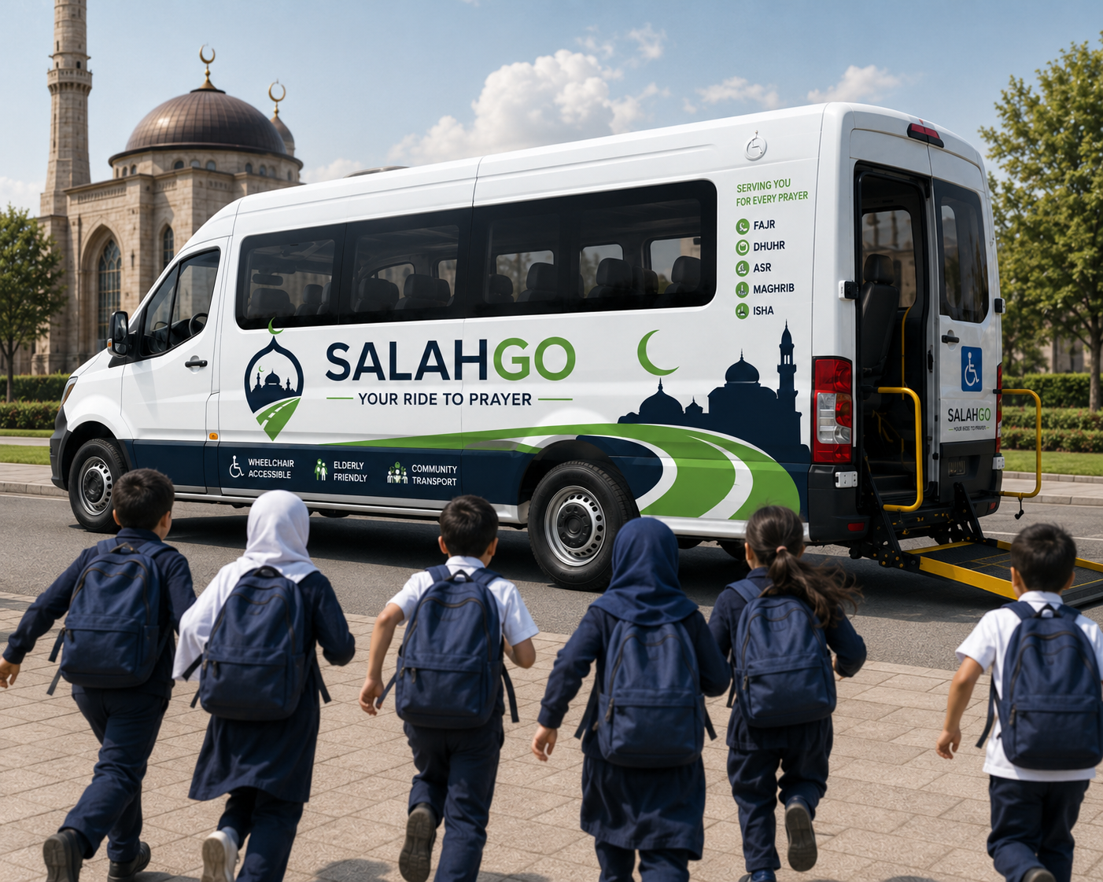
LAUNCH FEATURE
Madrasa journeys sit inside the normal booking flow.
When a family chooses Madrasa, the app asks for the extra details this journey needs: guardian consent, named handover, pickup rules, attendance windows and safeguarding notes.
1. Guardian and emergency contact
2. Pickup and drop-off location
3. Named handover person
4. Escort requirement
5. Safeguarding and attendance notes
Qur'an 16:90 - justice, excellence and care are commanded.
Notes:
This responds directly to the launch requirement: madrasa should not feel like a future add-on.
Say it clearly: it is selectable in the app, but the mosque team still checks safeguarding before any child journey runs.
For presentation: keep the phrase 'normal booking choice, extra safety checks'.

Slide 8
TRUST LAYER
Accessibility and safeguarding are part of every journey.
The first pilot must make care visible before every journey: who is travelling, what support is needed, who is responsible and what happened on the route.
Before booking
Before departure
Needs, consent, guardian, companion seat and route fit.
Driver/escort eligibility, manifest and pickup confirmation.
During journey
After return
Live status, route notes and coordinator visibility.
Handover confirmation, incident notes and impact log.
Qur'an 17:70 - human dignity must be honoured.
Notes:
Use this slide to show the mosque that safeguarding is designed in from day one.
Explain the four moments: before booking, before departure, during the journey and after return.
It is also a bridge to adviser/legal review before real passenger operations.

Slide 9
VOLUNTEER-FRIENDLY OPERATIONS
Some volunteer minibus routes may be possible without every driver holding D1.
Official guidance
Some drivers may be able to drive a minibus with up to 16 passenger seats on a car licence where strict non-commercial, voluntary and vehicle conditions are met.
This can help volunteer recruitment, but only after the vehicle, payment, driver eligibility, insurance and permit checks are confirmed.
Community permit
A permit may apply for voluntary organisations, including religious organisations, where the service benefits members and is not run for profit.
Launch rule
No public passenger operation until insurer and qualified transport advice confirms the route. Public wording should say 'may be possible', not 'no D1 needed'.
Qur'an 5:2 - help one another in goodness and mindful duty.
Source: gov.uk/driving-a-minibus
Notes:
Say this carefully. This is not legal advice and it is not a promise that every volunteer can drive.
The advantage is volunteer recruitment, but the responsible wording is conditional.
Reference GOV.UK and tell the mosque we will confirm with insurer and qualified advice before passengers travel.

Slide 10
WHAT SUCCESS LOOKS LIKE
The first target is participation, not revenue.
If SalahGo helps more people attend prayer, classes and community life reliably, the business model has evidence to grow.
10
25
50
2nd
regular Friday riders
regular Friday riders
registered members
route after proof
First proof that people will build a habit around the service.
Demand is visible enough to refine route windows and volunteer shifts.
Mosque team view, member groups and sponsored-seat records become necessary.
Expansion is earned by evidence, not ambition alone.
Track every week
Journeys completed, active members, sponsored seats used, accessibility journeys, car journeys reduced, no-shows, missed demand and feedback from the Masjid Ayesha team.
Qur'an 2:148 - compete with one another in good works.
Notes:
This slide reframes success for a community partner.
Revenue can come later; the pilot must first prove attendance and trust.
Use the milestones as a calm growth path: 10 regular riders, then 25, then 50 members, then consider route two.

Slide 11
COMMUNITY SUPPORT
Sponsorship turns transport into shared care.
A family, local business or supporter can sponsor journeys without needing to know private rider information.
Sponsor a journey
Sponsor Friday
Support accessibility
A single seat for someone who would otherwise miss out.
A full Jumuah loop funded by a family or business.
Help cover wheelchair-accessible and elderly-friendly journeys.
Qur'an 57:18 - charity given sincerely is multiplied.
Notes:
Keep this warm and practical.
The privacy line matters: sponsors fund the service, not access to vulnerable people's details.

Slide 12
LAUNCH PATH
A careful 90-day pilot can get us to a launch decision.
Days 1-30
Agree Masjid Ayesha pilot scope, pickup points, safety expectations, volunteer interest and public message.
The quickest route to launch is not more scope. It is a tight pilot with safety checks, route testing and real user registration.
Days 31-60
Run app registration, test Friday route timings, collect accessibility needs and prepare sponsored-seat records.
Days 61-90
Complete transport/insurance checks, rehearse route manifest, confirm launch date and publish first service window.
Qur'an 16:90 - justice, excellence and care are commanded.
Notes:
This slide converts the idea into next actions.
It also gives Masjid Ayesha a low-risk way to say yes to the first step.
Presenting tip: ask for agreement on days 1-30 first, not a full launch commitment on the spot.

Slide 13
OUR ASK
Let us begin with one Friday route.
SalahGo
We are asking Masjid Ayesha to help us validate need, confirm safe pickup points, recruit volunteers, test the app flow and measure community participation.
Your Ride To Prayer
Taking Care Of Everyone In The Community
1. How many members struggle with parking or travel?
2. How many elderly members miss activities?
3. Do sisters, families or new Muslims request safer transport?
4. Would one Friday route be a responsible first trial?
Helping People Reach The Mosque,
Not Just Transporting Them There.
Qur'an 3:104 - let there be a community calling to good.
Notes:
Close with one clear ask: permission to test a single Friday route.
This should feel practical, local and emotionally grounded.
Do not close by asking for a city-wide launch. Ask for a pilot conversation, safe pickup points and permission to test demand.

